Slide 1
Storage Locality and counting words

Slide 2

Counting the words in a long text
218718 words long
17150 different words
How many times does each word occur?

Slide 3
Task: count the number of occurrences of each word in very long text.
Input: Call me Ishmael. Some years ago--never mind how long precisely—having little or no money in my purse, and nothing particular to interest me onshore, I thought I would sail …
Moby dick: about 1.3MByte
Desired output:
Call: 354
Me: 53423
Ismael: 1322
….

Slide 4
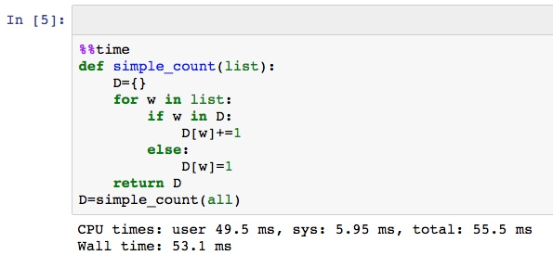
Simple solution
Iterate over words. Update counter for current word.

Slide 5
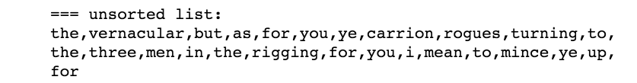
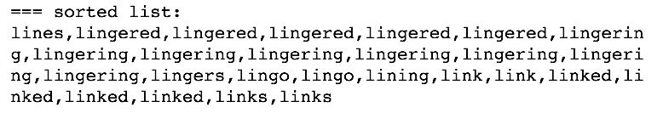
Lets use a sorted list
5
8

Slide 6
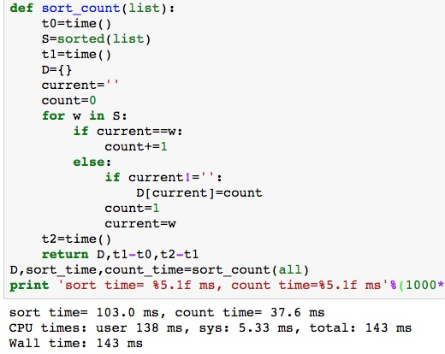
Sort-based solution
Sort words
Iterate over sorted list
Count occurrences of same word
Switch on word boundry

Slide 7
Summary
Sorting improves memory locality for word counting
Improved memory locality reduces run-time
Why? Because computer memory is organized in a hierarchy.

Slide 8
Storage Latency
Small and Fast vs. Large and Slow

Slide 9
CPU
Storage
A
A
C
C
=
*
B
B

Slide 10
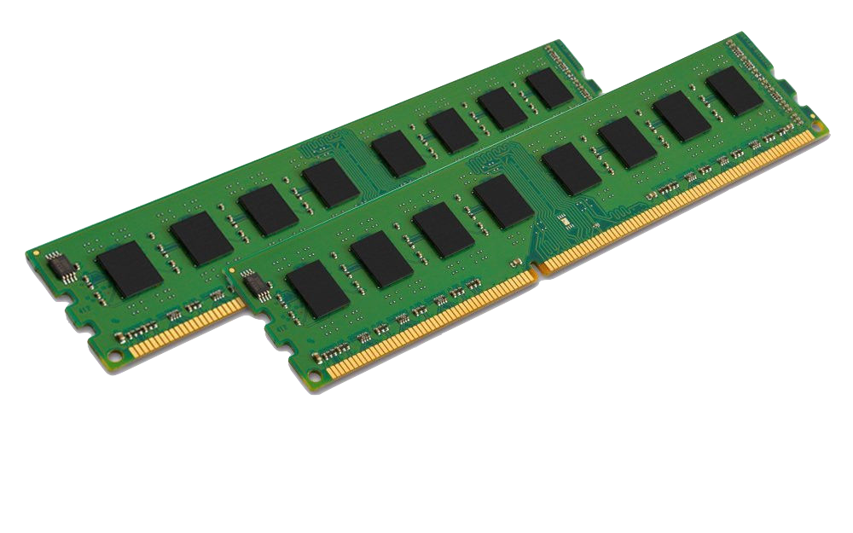
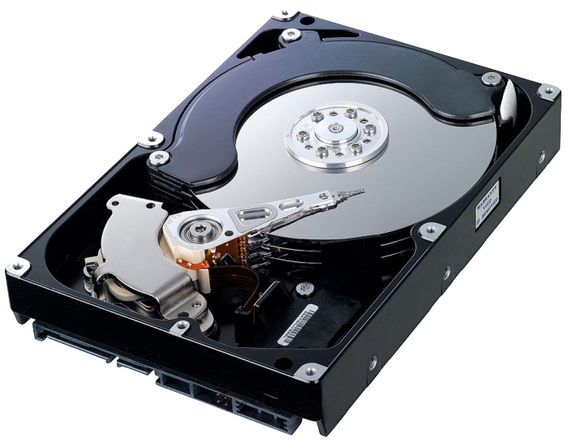

Latencies
Storage Types
Read A
Read B
C=A*B
Write C
With big data, most of the latency is memory latency (1,2,4), not computation (3)
Main Memory (RAM)
Spinning disk
Remote computer
Latency 1
Total Latency
Latency 2
TIME
Latency 3
Latency 4

Slide 11
NON-LOCAL STORAGE ACCESS
CPU
00…00
00…01
00…02
…….
…….
…….
Storage
start
A
A
50…00
50…01
50…02
…….
…….
…….
C
C
=
*
middle
99…00
99…01
99…02
…….
…….
…….
end
B
B

Slide 12
LOCAL STORAGE ACCESS
CPU
00…00
00…01
00…02
…….
…….
…….
A=0
For i in range(100000):
A+= X[i]
For i in range(100000):
A-= Y[i]
start
Storage
X
50…00
50…01
50…02
…….
…….
…….
middle
Y
99…00
99…01
99…02
…….
…….
…….
end

Slide 13
Summary
The major source of latency in data analysis is reading and writing to storage
Different types of storage offer different latency, capacity and price.
Big data analytics revolves around methods for organizing storage and computation in ways that maximize speed while minimizing cost.
Next, Caches and the memory Hierarchy.

Slide 14
Caches and the Memory Hierarchy
Notes:
Zoom: In the previous video we saw how locality can speed up the processing of large arrays.
However, I did not say *why* locality of access is important.
In this video I will tell you how caches work, what is the memory Heirarchy, and how all that is related to memory locality.

Slide 15
Latency, size and price of computer memory
Given a budget, we need to trade off
$10: Fast & Small
$10: Slow & Large

Slide 16
Cache: The basic idea
Slow & Large
Fast & Small
Memory
0 | 1 | 2 | 3 | 4 | 5 | 6 | 7 | 8 | 9
10 | 11 | 12 | 13 | 14 | 15 | 16 | 17 | 18 | 19
20 | 21 | 22 | 23 | 24 | 25 | 26 | 27 | 28 | 29
30 | 31 | 32 | 33 | 34 | 35 | 36 | 37 | 38 | 39
40 | 41 | 42 | 43 | 44 | 45 | 46 | 47 | 48 | 49
50 | 51 | 52 | 53 | 54 | 55 | 56 | 57 | 58 | 59
60 | 61 | 62 | 63 | 64 | 65 | 66 | 67 | 68 | 69
70 | 71 | 72 | 73 | 74 | 75 | 76 | 77 | 78 | 79
Cache
cpu
12 | 67
50 | 51
52 | 53
32 | 33

Slide 17
Cache Hit
Memory
0 | 1 | 2 | 3 | 4 | 5 | 6 | 7 | 8 | 9
10 | 11 | 12 | 13 | 14 | 15 | 16 | 17 | 18 | 19
20 | 21 | 22 | 23 | 24 | 25 | 26 | 27 | 28 | 29
30 | 31 | 32 | 33 | 34 | 35 | 36 | 37 | 38 | 39
40 | 41 | 42 | 43 | 44 | 45 | 46 | 47 | 48 | 49
50 | 51 | 52 | 53 | 54 | 55 | 56 | 57 | 58 | 59
60 | 61 | 62 | 63 | 64 | 65 | 66 | 67 | 68 | 69
70 | 71 | 72 | 73 | 74 | 75 | 76 | 77 | 78 | 79
Cache
cpu
Cache Hit
12 | 67
50 | 51
52 | 53
32 | 33

Slide 18
Cache Miss
Memory
0 | 1 | 2 | 3 | 4 | 5 | 6 | 7 | 8 | 9
10 | 11 | 12 | 13 | 14 | 15 | 16 | 17 | 18 | 19
20 | 21 | 22 | 23 | 24 | 25 | 26 | 27 | 28 | 29
30 | 31 | 32 | 33 | 34 | 35 | 36 | 37 | 38 | 39
40 | 41 | 42 | 43 | 44 | 45 | 46 | 47 | 48 | 49
50 | 51 | 52 | 53 | 54 | 55 | 56 | 57 | 58 | 59
60 | 61 | 62 | 63 | 64 | 65 | 66 | 67 | 68 | 69
70 | 71 | 72 | 73 | 74 | 75 | 76 | 77 | 78 | 79
Cache
cpu
12 | 67
50 | 51
52 | 53
32 | 33

Slide 19

Cache Miss Service: 1) Choose byte to drop
Memory
0 | 1 | 2 | 3 | 4 | 5 | 6 | 7 | 8 | 9
10 | 11 | 12 | 13 | 14 | 15 | 16 | 17 | 18 | 19
20 | 21 | 22 | 23 | 24 | 25 | 26 | 27 | 28 | 29
30 | 31 | 32 | 33 | 34 | 35 | 36 | 37 | 38 | 39
40 | 41 | 42 | 43 | 44 | 45 | 46 | 47 | 48 | 49
50 | 51 | 52 | 53 | 54 | 55 | 56 | 57 | 58 | 59
60 | 61 | 62 | 63 | 64 | 65 | 66 | 67 | 68 | 69
70 | 71 | 72 | 73 | 74 | 75 | 76 | 77 | 78 | 79
Cache
cpu
12 | 67
50 | 51
52 | 53
32 | 33
67

Slide 20
Cache Miss Service: 2) write back
Memory
0 | 1 | 2 | 3 | 4 | 5 | 6 | 7 | 8 | 9
10 | 11 | 12 | 13 | 14 | 15 | 16 | 17 | 18 | 19
20 | 21 | 22 | 23 | 24 | 25 | 26 | 27 | 28 | 29
30 | 31 | 32 | 33 | 34 | 35 | 36 | 37 | 38 | 39
40 | 41 | 42 | 43 | 44 | 45 | 46 | 47 | 48 | 49
50 | 51 | 52 | 53 | 54 | 55 | 56 | 57 | 58 | 59
60 | 61 | 62 | 63 | 64 | 65 | 66 | 67 | 68 | 69
70 | 71 | 72 | 73 | 74 | 75 | 76 | 77 | 78 | 79
Cache
cpu
12
50 | 51
52 | 53
32 | 33
67

Slide 21
Cache Miss Service: 3) Read In
Memory
0 | 1 | 2 | 3 | 4 | 5 | 6 | 7 | 8 | 9
10 | 11 | 12 | 13 | 14 | 15 | 16 | 17 | 18 | 19
20 | 21 | 22 | 23 | 24 | 25 | 26 | 27 | 28 | 29
30 | 31 | 32 | 33 | 34 | 35 | 36 | 37 | 38 | 39
40 | 41 | 42 | 43 | 44 | 45 | 46 | 47 | 48 | 49
50 | 51 | 52 | 53 | 54 | 55 | 56 | 57 | 58 | 59
60 | 61 | 62 | 63 | 64 | 65 | 66 | 67 | 68 | 69
70 | 71 | 72 | 73 | 74 | 75 | 76 | 77 | 78 | 79
Cache
cpu
12
50 | 51
52 | 53
32 | 33
47

Slide 22
Access Locality
The cache is effective If most accesses are hits.
Cache Hit Rate is high.
Temporal Locality: Multiple accesses to same address within a short time period

Slide 23
Spatial locality
Spatial Locality: Multiple accesses to close-together addresses in short time period.
The difference between two sums.
Counting words by sorting
Benefiting from spatial locality
Memory is partitioned into Blocks/Lines rather than single bytes.
Moving a block of memory takes much less time than moving each byte individually.
Memory locations that are close to each other are likely to fall in the same block.
Resulting in more cache hits.

Slide 24
Cache: Lines / Blocks
Memory
0 | 1 | 2 | 3 | 4 | 5 | 6 | 7 | 8 | 9
10 | 11 | 12 | 13 | 14 | 15 | 16 | 17 | 18 | 19
20 | 21 | 22 | 23 | 24 | 25 | 26 | 27 | 28 | 29
30 | 31 | 32 | 33 | 34 | 35 | 36 | 37 | 38 | 39
40 | 41 | 42 | 43 | 44 | 45 | 46 | 47 | 48 | 49
50 | 51 | 52 | 53 | 54 | 55 | 56 | 57 | 58 | 59
60 | 61 | 62 | 63 | 64 | 65 | 66 | 67 | 68 | 69
70 | 71 | 72 | 73 | 74 | 75 | 76 | 77 | 78 | 79
Cache
cpu
50 | 51
52 | 53
32 | 33
34 | 35
Supports Spatial locality

Slide 25
Unsorted word count / poor locality
Consider the memory access to the dictionary D:
Count without sort: D[the]=12332,…,D[but]=943,………,D[vernacular]=10,……….....,D[for]=..
Temporal locality for very common words like “the”
No spatial locality

Slide 26
sorted word count / good locality
Entries to D are added one at a time.
D[lines]=33
D[lines]=33, D[lingered]=5
D[lines]=33, D[lingered]=5, D[lingering]=8
Assuming new entries are added at the end, this gives spatial locality.
Spatial locality makes code run faster

Slide 27
Summary
Caching reduces storage latency by bringing relevant data close to the CPU.
This requires that code exhibits access locality:
Temporal locality: Accessing the same location multiple times
Spatial locality: Accessing neighboring locations.

Slide 28
The memory Hierarchy

Slide 29
The Memory Hierarchy
Real systems have a several levels storage types:
Top of hierarchy: Small and fast storage close to CPU
Bottom of Hierarchy: Large and slow storage further from CPU
Caching is used to transfer data between different levels of the hierarchy.
Programmer / compiler is oblivious:
The hardware provides an abstraction : memory looks like like a single large array.
But performance depends on program’s access pattern.

Slide 30
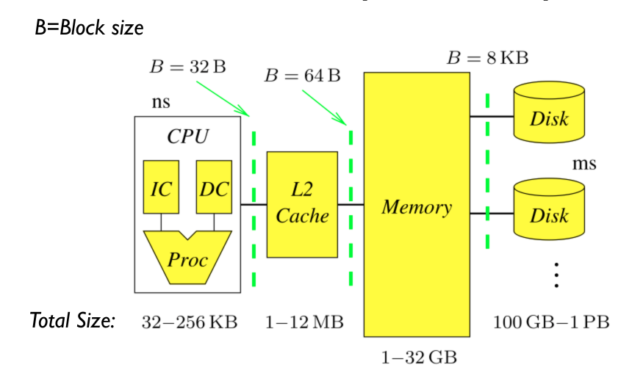
The Memory Hierarchy

Slide 31
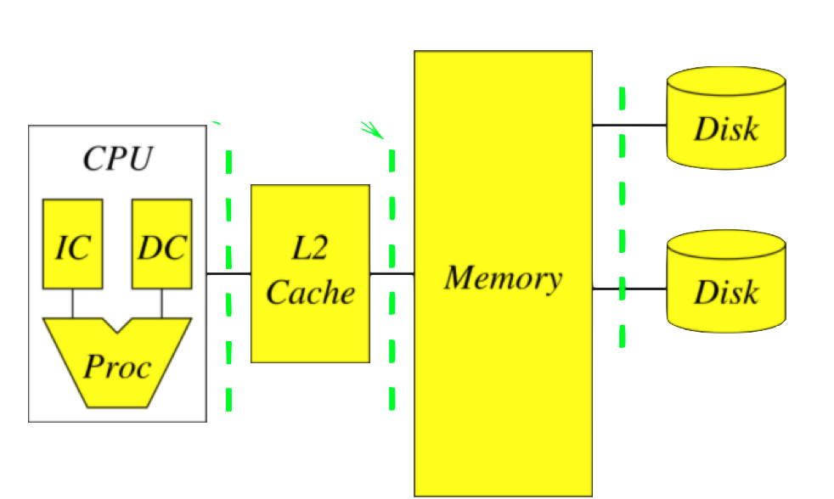
Computer clusters extend the memory hierarchy
A data processing cluster is simply many computers linked through an ethernet connection.
Storage is shared
Locality: Data to reside on the computer that will use it.
“Caching” is replaced by “Shuffling”
Abstraction is spark RDD.
Ethernet

Slide 32
Sizes and latencies in a typical memory hierarchy.
 | CPU (Registers) | L1 Cache | L2 Cache | L3 Cache | Main Memory | Disk Storage | Local Area Network
Size (bytes) | 1KB | 64KB | 256KB | 4MB | 4-16GB | 4-16TB | 16TB – 10PB
Latency | 300ps | 1ns | 5ns | 20ns | 100ns | 2-10ms | 2-10ms
Block size | 64B | 64B | 64B | 64B | 32KB | 64KB | 1.5-64KB
12 orders of magnitude
6 orders of magnitude

Slide 33
Summary
Memory Hierarchy: combining storage banks with different latencies.
Clusters: multiple computers, connected by ethernet, that share their storage.

Slide 34
A short history of affordable massive computing.

Slide 35
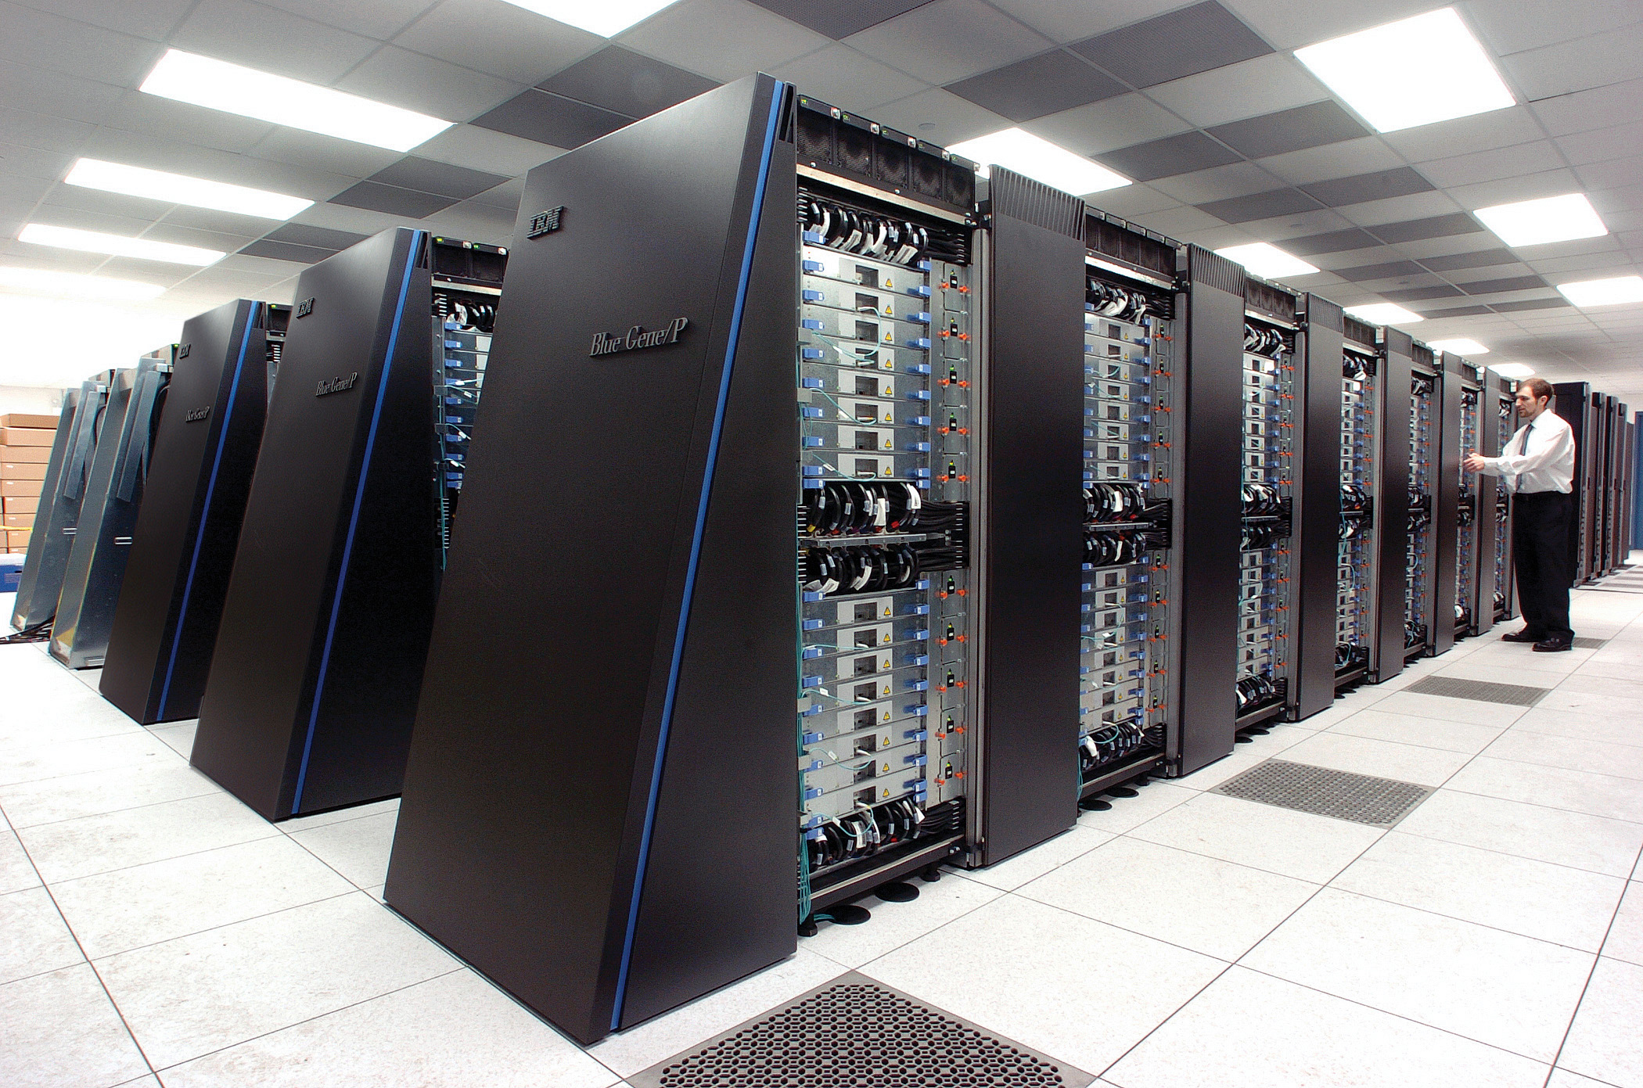
Super computers
Cray, Deep Blue, Blue Gene …
Specialized hardware
Very expensive
created to solve specialized important problems

Slide 36

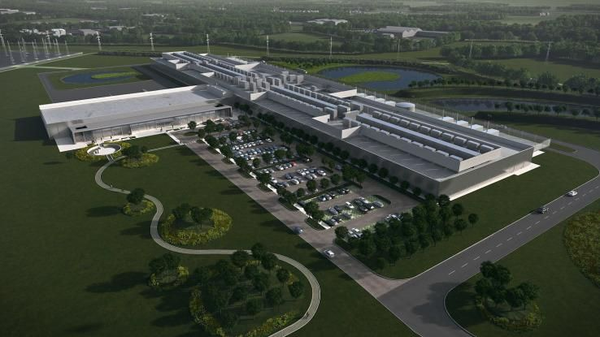
Data Centers

Slide 37
Data Centers
The physical aspect of ”the cloud”
Collection of commodity computers
VAST number of computers (100,000’s)
Created to provide computation for large and small organizations.
Computation as a commodity.

Slide 38
Making History: Google 2003
Larry Page and Sergey Brin develop a method for storing very large files on multiple commodity computers.
Each file is broken into fixed-size chunks.
Each chunk is stored on multiple chunk servers.
The locations of the chunks is managed by the master

Slide 39
HDFS: Chunking files
File 1, Chunk 1
Copy 2
File 1
Split
File 1, Chunk 1
Copy
File 1, Chunk 1
Copy 1
File 1, Chunk 2
Copy 2
File 1, Chunk 2
File 1, Chunk 2
Copy 1
File 1, Chunk 2
Copy 3
File 2, Chunk 1
Copy 2
File 2
Split
File 2, Chunk 1
Copy
File 2, Chunk 1
Copy 1
File 2, Chunk 2
Copy 2
File 2, Chunk 2
File 2, Chunk 2
Copy 1

Slide 40
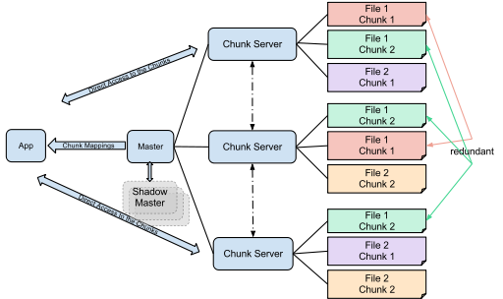
HDFS: Distributing Chunks
File 1, Chunk 1
Copy 1
File 1, Chunk 1
Copy 2
File 1, Chunk 2
Copy 1
File 1, Chunk 2
Copy 2
File 1, Chunk 2
Copy 3
File 2, Chunk 1
Copy 1
File 2, Chunk 1
Copy 2
File 2, Chunk 2
Copy 1
File 2, Chunk 2
Copy 2

Slide 41
Properties of GFS/HDFS
Commodity Hardware: Low cost per byte of storage.
Locality: data stored close to CPU.
Redundancy: can recover from server failures.
Simple abstraction: looks to user like standard file system (files, directories, etc.) Chunk mechanism is hidden.

Slide 42

Redundancy

Slide 43
Parallelism
Serial computation: do everything on one computer
Assume File 1 contains a list of numbers.
Task:
Sum all of the numbers in file 1
Parallel method: process each chunk on a separate computer, then combine.

Slide 44
Locality
Because of redundancy it is likely that at any moment there exists an available worker that contains the chunk the master wishes to process.

Slide 45
Map-Reduce
HDFS is a storage abstraction
Map-Reduce is a computation abstraction that works well with HDFS
Allows programmer to specify parallel computation without knowing how the hardware is organized.
We will describe Map-Reduce, using Spark, in a later section.

Slide 46
Spark
Developed by Matei Zaharia , amplab, 2014
Hadoop uses shared file system (disk)
Spark uses shared memory – faster, lower latency.
Will be used in this course
Recall word count by sorting, we will redo it using map-reduce!

Slide 47
Summary
Big data analysis is performed on large clusters of commodity computers.
HDFS (Hadoop file system): break down files to chunks, make copies, distribute randomly.
Hadoop Map-Reduce: a computation abstraction that works well with HDFS
Spark: Sharing memory instead of sharing disk.

